Slide 1
Charles Stricker, Jin Joy Mao,
Dylan Colbert, Sarah Cassidy & Bryan Roche
The Impact of SMART on Educational Aptitude using the Pennsylvania Department of Educational Classroom Diagnostic Tools.

Slide 2
Behavior Analysis & Intelligence
Intelligence is commonly believed to lie beyond the remit and descriptive powers of behavior analysis
  Theoretical objections to hypothetical constructs (Skinner, 1974)
  Preference for functional accounts
  Apparent difficulty in accounting for the generativity of language and cognition
However, advances in the functional analysis of language and cognition, using Relational Frame Theory (RFT), have led to new insights into how we might conceive and improve intellectual behavior.

Slide 3
Derived Relational Responding
If an individual is taught the relation between a set of stimuli, they will then be able to further derive relations that have not be explicitly trained.
Furthermore, following training on a sufficient number of exemplars with a wide array of stimuli, derived relational responding emerges as a generalized operant.

Slide 4
Relational Frame Theory
Relational responding comes in a variety of forms or ‘frames’
coordination “cat is the same as kitty”
opposition “big is opposite to small”
hierarchy “an apple is a type of fruit”
analogy “foot is to sock, as hand is to glove”
Perspective-taking “I am here and you are there”
Temporality “morning comes before afternoon”
RFT suggests that a relatively small variety of relational frames may yield the full array of cognitive skills, like deductive reasoning, problem solving, analogical reasoning and language .
Notes:
*referred to as a verb rather than a noun, to draw attention to framing as a behavioral skill rather than to frames as mental entities.

Slide 5
Intelligence & Relational Skills
There already exists a substantial amount of research supporting a close relationship between relational responding and performance on IQ tests.
  Coordination/Opposition and Comparison Relations with Full Scale IQ (r = .74, p<.001), Verbal IQ (r = .78, p<.001), & Performance IQ (r = .55, p<.005). (Colbert et al., 2017)
  Relational skills and the National Adult Reading Test (r = .58, p<.001), Rey Auditory Learning Test (r = .69, p<.001), Trail Making Test (r = .36, p<.05) (Colbert et al., 2017)
Temporal Relations with WAIS-III FSIQ, VIQ, Vocabulary & Arithmetic (O’Hora et al., 2008; 2005)
Coordination, comparison, and temporal relations with K-BIT (O’Toole et al., 2009)

Slide 7
A is the Same as B
B is Opposite to C
Is A the Same as C?

Slide 8
A is Opposite to B
B is Opposite to C
Is A Opposite to C?

Slide 9
A is More Than B
C is Less Than B
Is A More than C?

Slide 10
Cassidy, Roche & Hayes (2011)

Slide 11
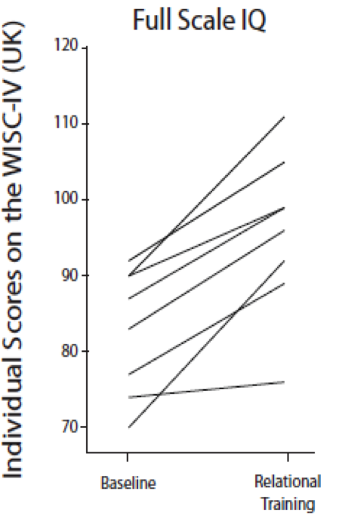
Cassidy, Roche & Hayes (2011)
Experiment 2

Slide 12
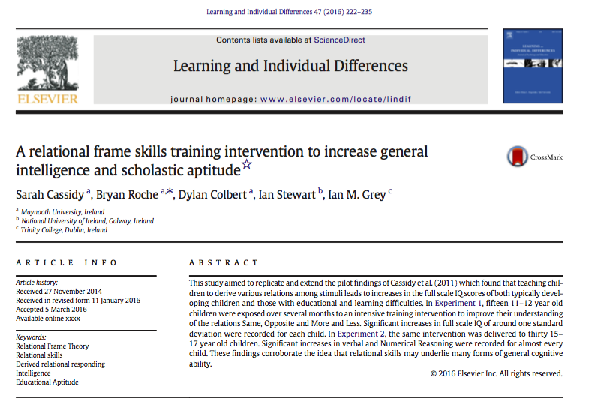

Slide 13
Training Structure
55 relational training task-types trained into 55 separate blocks of potentially infinte length
  Blocks 1-29: Same/Opposite
  Block 20-55: More than/Less than
Subjects cycle between training and testing for each of 55 stages until a training block(16 consecutive correct) and a test block (16 consecutive correct out of 16) are passed consecutively.
Response Window of 30s.
Every single trial of every task type task employs unique nonsense word stimuli - even on recycling.
Tasks get progressively more complex across blocks

Slide 14
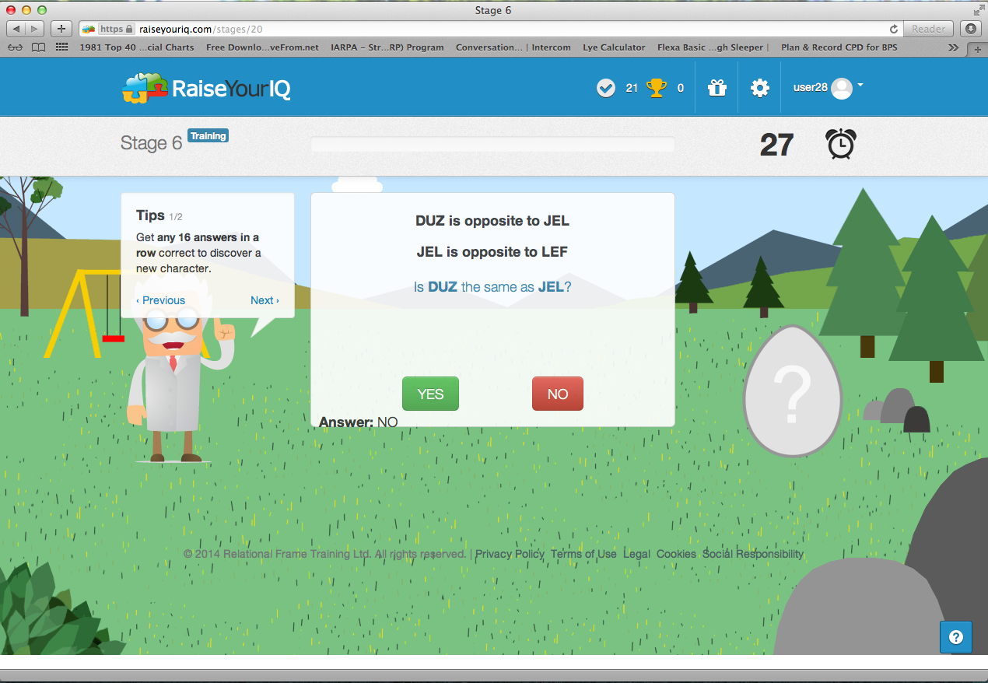
Notes:
And we ended up with a prototype that were able to test with the school children here at Rathmore. They jhelped us create the toolbecause we used their feedback to create new characters, and badges and they taught us hwo important it was to earn points, and to get extra points for revising regularly. And the trool got better and better over the long time we were faciluated here at the school.

Slide 15
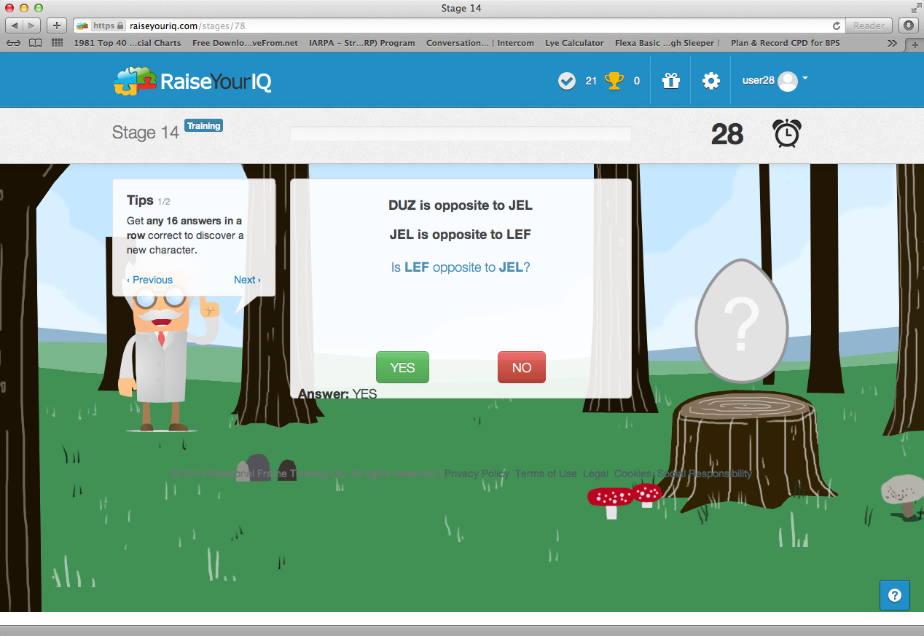
Notes:
And we ended up with a prototype that were able to test with the school children here at Rathmore. They jhelped us create the toolbecause we used their feedback to create new characters, and badges and they taught us hwo important it was to earn points, and to get extra points for revising regularly. And the trool got better and better over the long time we were faciluated here at the school.

Slide 16
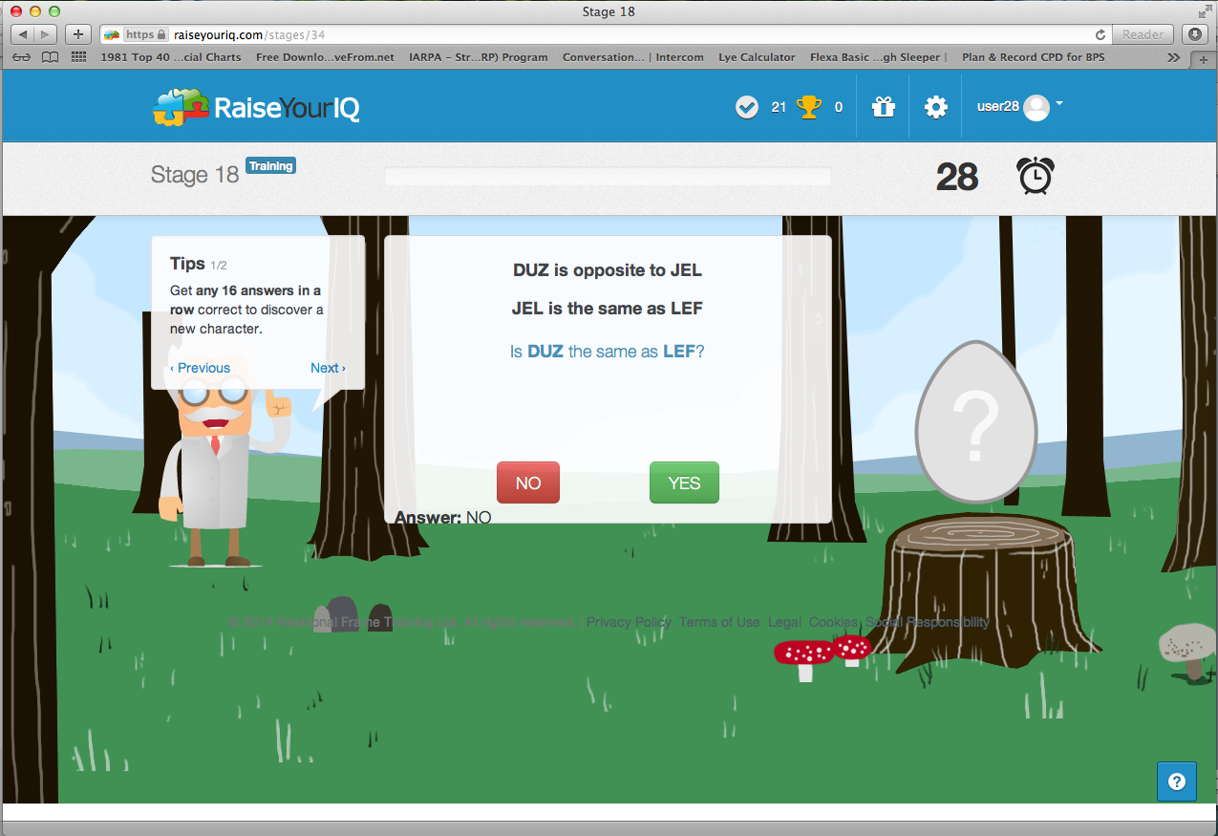
Notes:
And we ended up with a prototype that were able to test with the school children here at Rathmore. They jhelped us create the toolbecause we used their feedback to create new characters, and badges and they taught us hwo important it was to earn points, and to get extra points for revising regularly. And the trool got better and better over the long time we were faciluated here at the school.

Slide 17
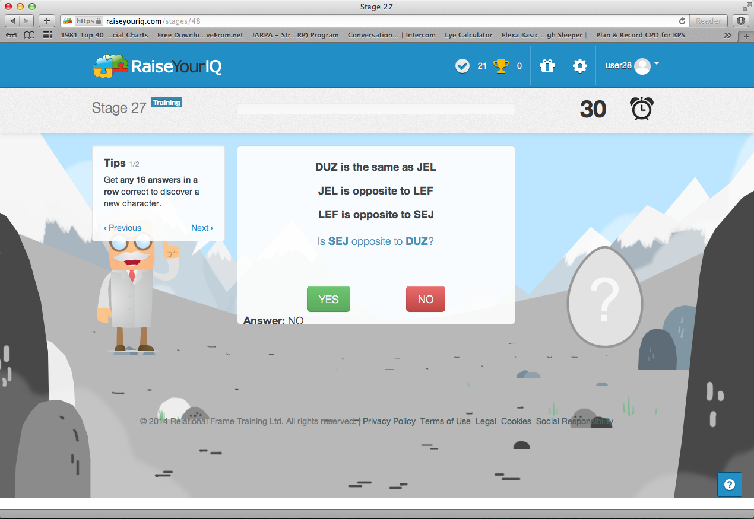
Notes:
And we ended up with a prototype that were able to test with the school children here at Rathmore. They jhelped us create the toolbecause we used their feedback to create new characters, and badges and they taught us hwo important it was to earn points, and to get extra points for revising regularly. And the trool got better and better over the long time we were faciluated here at the school.

Slide 18

Notes:
And we ended up with a prototype that were able to test with the school children here at Rathmore. They jhelped us create the toolbecause we used their feedback to create new characters, and badges and they taught us hwo important it was to earn points, and to get extra points for revising regularly. And the trool got better and better over the long time we were faciluated here at the school.

Slide 19
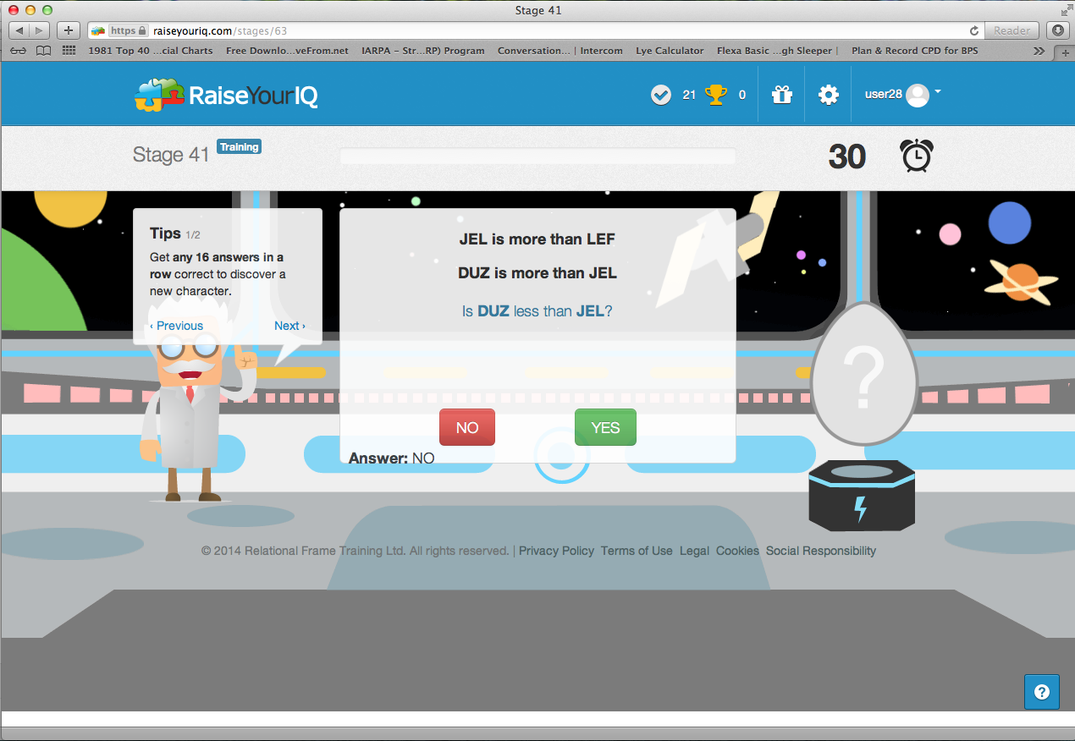
Notes:
And we ended up with a prototype that were able to test with the school children here at Rathmore. They jhelped us create the toolbecause we used their feedback to create new characters, and badges and they taught us hwo important it was to earn points, and to get extra points for revising regularly. And the trool got better and better over the long time we were faciluated here at the school.

Slide 20
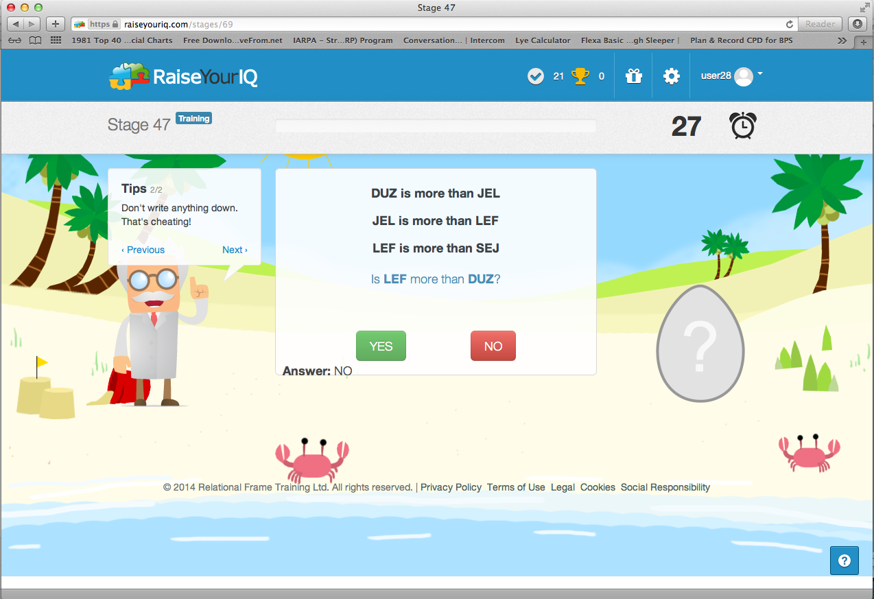
Notes:
And we ended up with a prototype that were able to test with the school children here at Rathmore. They jhelped us create the toolbecause we used their feedback to create new characters, and badges and they taught us hwo important it was to earn points, and to get extra points for revising regularly. And the trool got better and better over the long time we were faciluated here at the school.

Slide 21

Notes:
And we ended up with a prototype that were able to test with the school children here at Rathmore. They jhelped us create the toolbecause we used their feedback to create new characters, and badges and they taught us hwo important it was to earn points, and to get extra points for revising regularly. And the trool got better and better over the long time we were faciluated here at the school.

Slide 22
Cassidy et al., (2016) Experiment 1
The increase in IQ from baseline to follow up was significant (t=19.18, df =14, p<0.001).
Effect size = 4.96 (Cohen’s d, large)

Slide 23
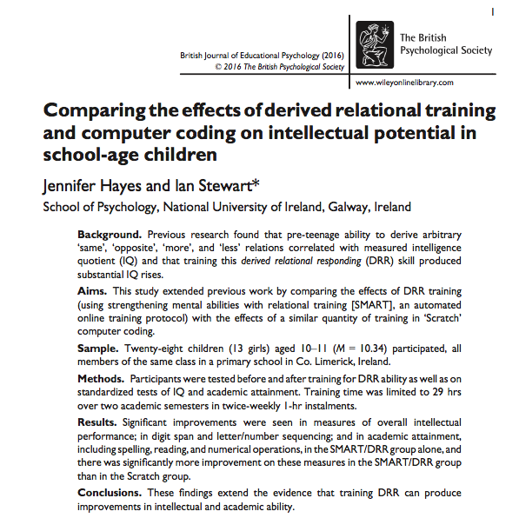

Slide 24
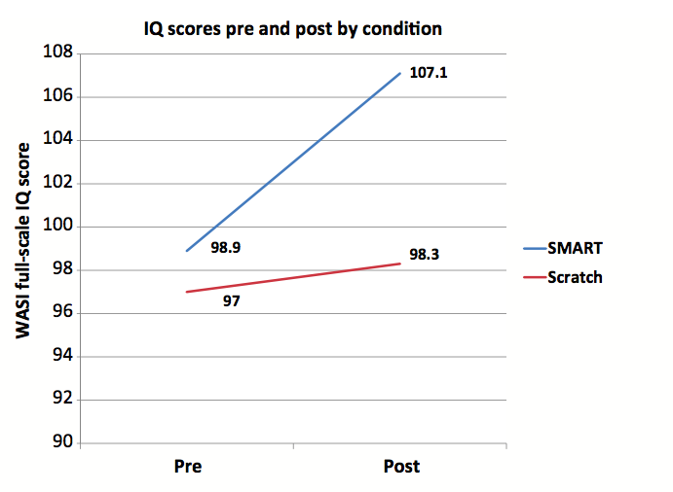
Hayes & Stewart 2016

Slide 25
Summary of IQ Gain Studies Using SMART
  Training in Sameness, Opposition & Comparison relations resulted in increase of 13 points in WICS-IV FSIQ for a group of primary school students (Cassidy, et al., 2011)
  Circa two point rise on Raven’s Progressive Matrices, .5 point for controls. Statistically significant and effect was a function of extent of training. Thiurs, Starbrink, Jannson (2016).
  Teaching relational frames of coordination and opposition led to increase on McCarthy’s Aptitude Scales in young children (Parra & Ruiz, 2016; Vizcaíno-Torres, Ruiz, Luciano, López-López, Barbero-Rubio, & Gil, 2015).
  Circa 8 point IQ rise (WASI) in a group of secondary school students following relational training. Active controls experienced 1 point rise. (Stewart & Hayes, 2016).
  Mean 23 point rise in WISC-IV FSIQ in a group of secondary school students following relational training (Cassidy et al., 2016).
  Circa 5 point rise in Standard Raven Progressive Matrices scores for children who partially completed Same/Opposite training compared to less than 1 point for those who did not (Amd & Roche., 2018).
  Circa 19 point rise (WASI) for children exposed to Same/Opposite and More/Less training, Less than one point gain for passive control group (Colbert, Tyndall, Roche., & Cassidy, 2018).
  McLoughlin, Tyndall, & Pereira (In press). Average of 6 point FSIQ gain for 13-14 yr old children over matched active controls (gain of 1.9 points) using very minimal SMART training.

Slide 26
What is needed is a well-matched randomized assignment study, examining the real-world benefits of SMART training in terms of scores on national or state assessment used to index academic attainment and make educational decisions about individuals.
The Current Study
60 children, 15-17 years, matched based on scores on Pennsylvania classroom diagnostic tools (CDT)
Passive Control Group
Independent test administrators and training supervisors
All Participants finished training (55 stages) in 12 weeks.
Lost one (treatment) participant due to non-completion of follow-up assessment (n=59).

Slide 27
Study Outline: Intervention Group
Allocation of children to matched groups by teachers based on prior Pennsylvania CDT assessments
Intervention
2-3 X 45 mins. per week for 12 weeks
School Based
Follow-up
CDT Assessment (Single Blind)
Baseline
CDT Assessment
(Single Blind)

Slide 28
Study Outline: Controls
Allocation of children to matched groups by teachers based on prior Pennsylvania CDT assessments
TAU
12 weeks
Follow-up
CDT Assessment (Single Blind)
Baseline
CDT Assessment
(Single Blind)

Slide 29
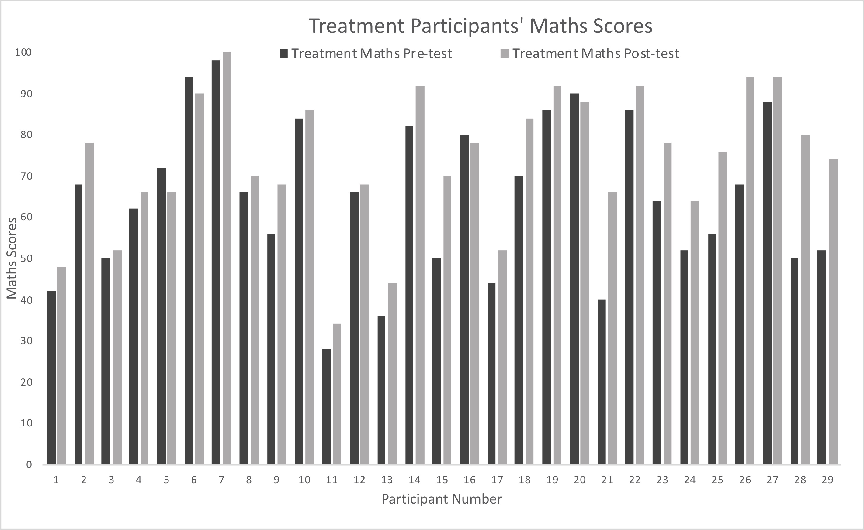
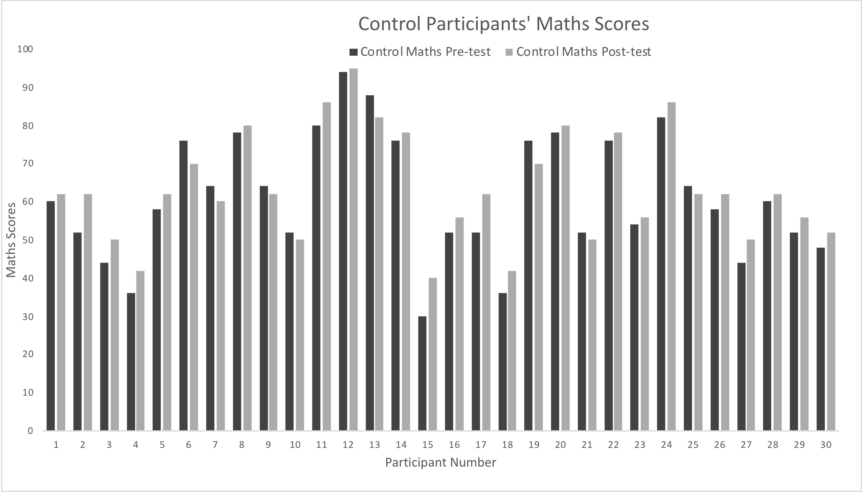

Slide 30
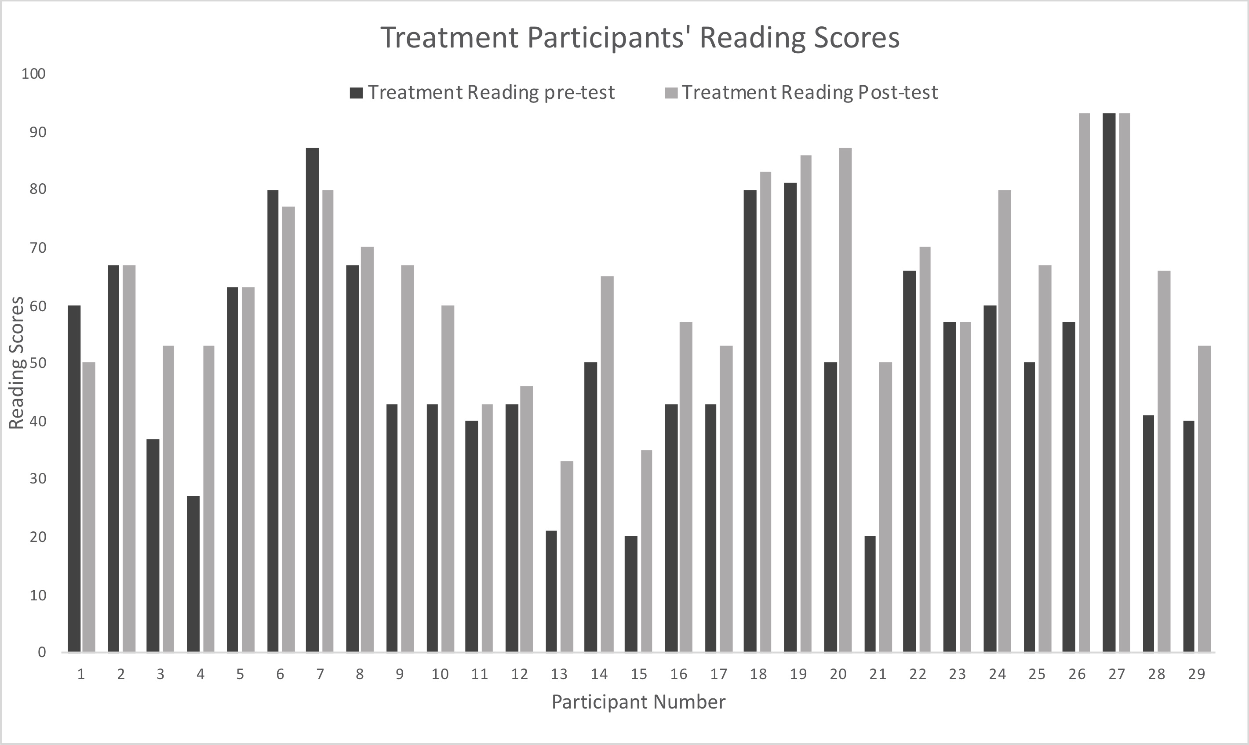
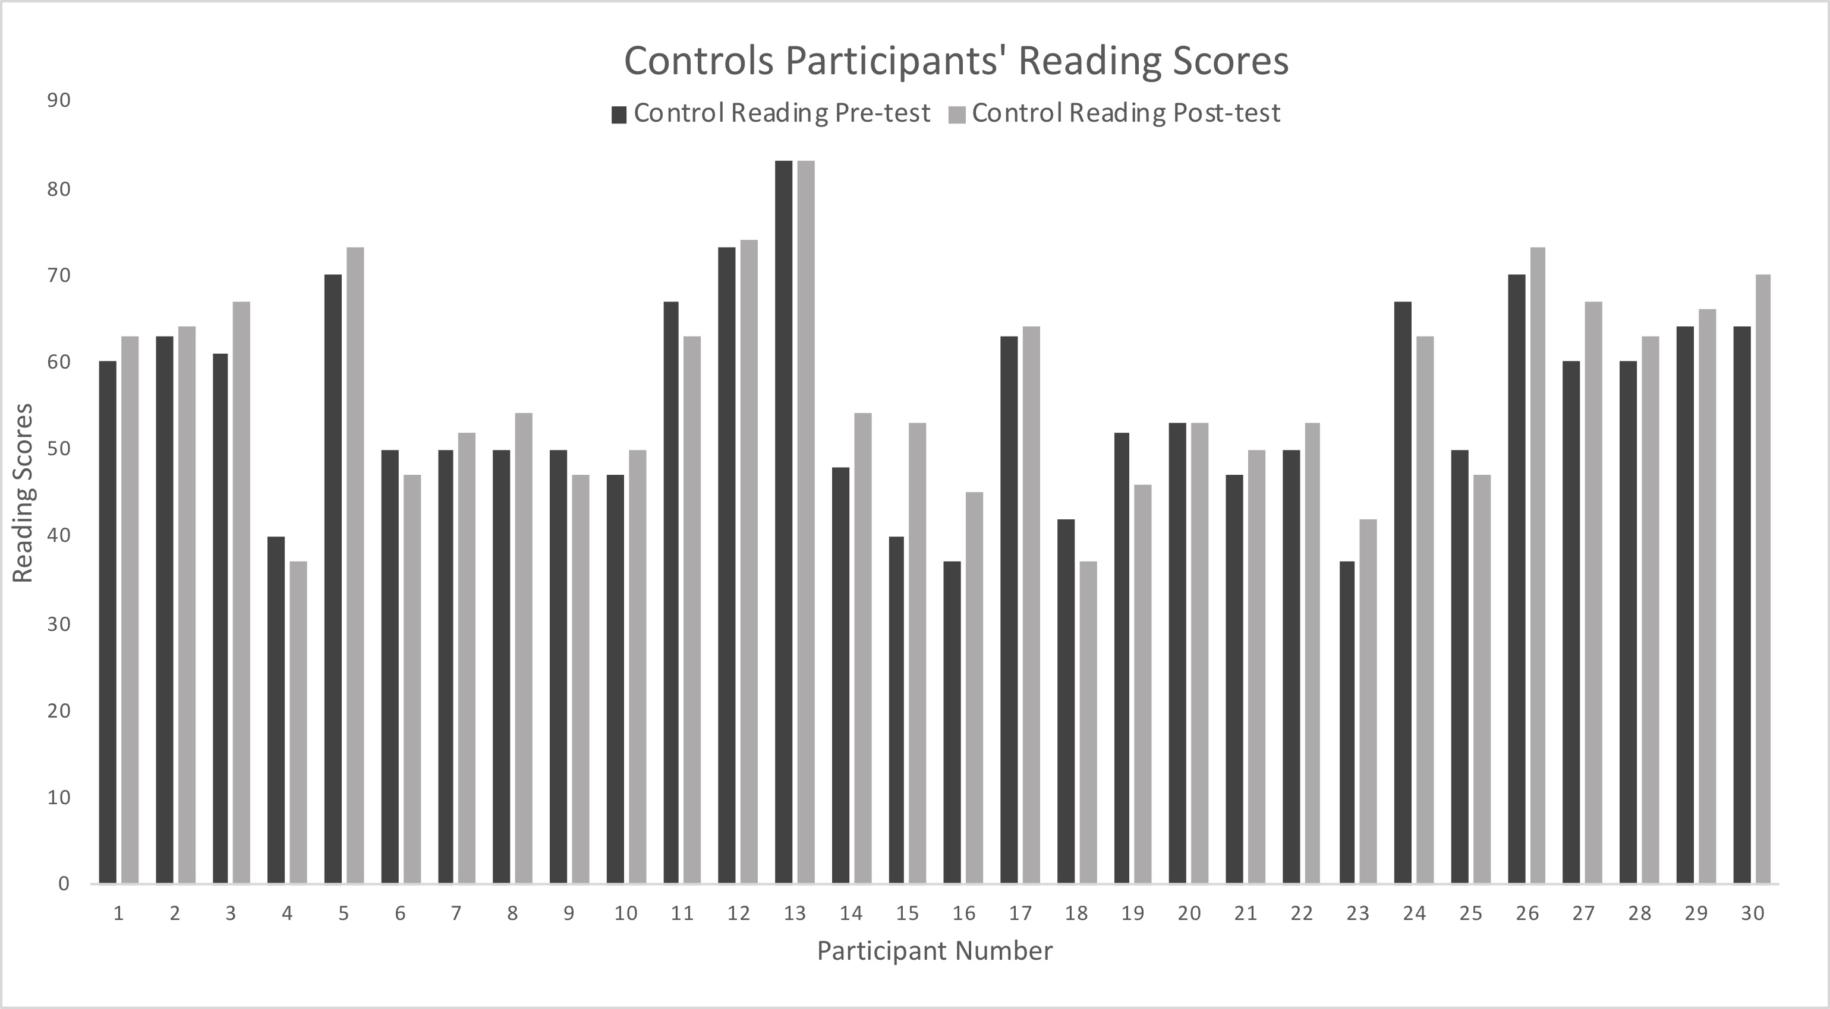

Slide 31
 |  | N | Mean | Min | Max | Standard Deviation | Variance | Median | Mode
Control Group
 | Pre-Test Math Score | 30 | 61.20 | 30 | 94 | 16.22 | 263.3 | 59.0 | 52
 | Pre-Test Reading Score | 30 | 55.60 | 37 | 83 | 11.51 | 132.5 | 52.5 | 50
 | Post-Test Math Score | 30 | 63.50 | 40 | 95 | 14.30 | 204.6 | 62.0 | 62
 | Post-Test Reading Score | 30 | 57.33 | 37 | 83 | 11.66 | 136.0 | 54.0 | 63
 | Math Growth | 30 | 2.30 | -6 | 10 | 4.50 | 20.2 | 2.0 | 2
 | Reading Growth | 30 | 1.77 | -6 | 13 | 4.36 | 19.0 | 2.5 | 3
Experimental Group
 | Pre-Test Math Score | 29 | 64.83 | 28 | 98 | 18.83 | 354.4 | 66.0 | 50
 | Pre-Test Reading Score | 29 | 52.72 | 20 | 93 | 19.76 | 390.4 | 50.0 | 43
 | Post-Test Math Score | 29 | 73.93 | 34 | 100 | 16.66 | 277.6 | 76.0 | 66^{b}
 | Post-Test Reading Score | 29 | 64.03 | 33 | 93 | 16.26 | 264.2 | 65.0 | 53
 | Math Growth | 29 | 9.24 | -6 | 30 | 9.33 | 87.0 | 6.0 | 6
 | Reading Growth | 29 | 11.24 | -10 | 36 | 12.19 | 148.6 | 12.0 | 0^{b}

Slide 32
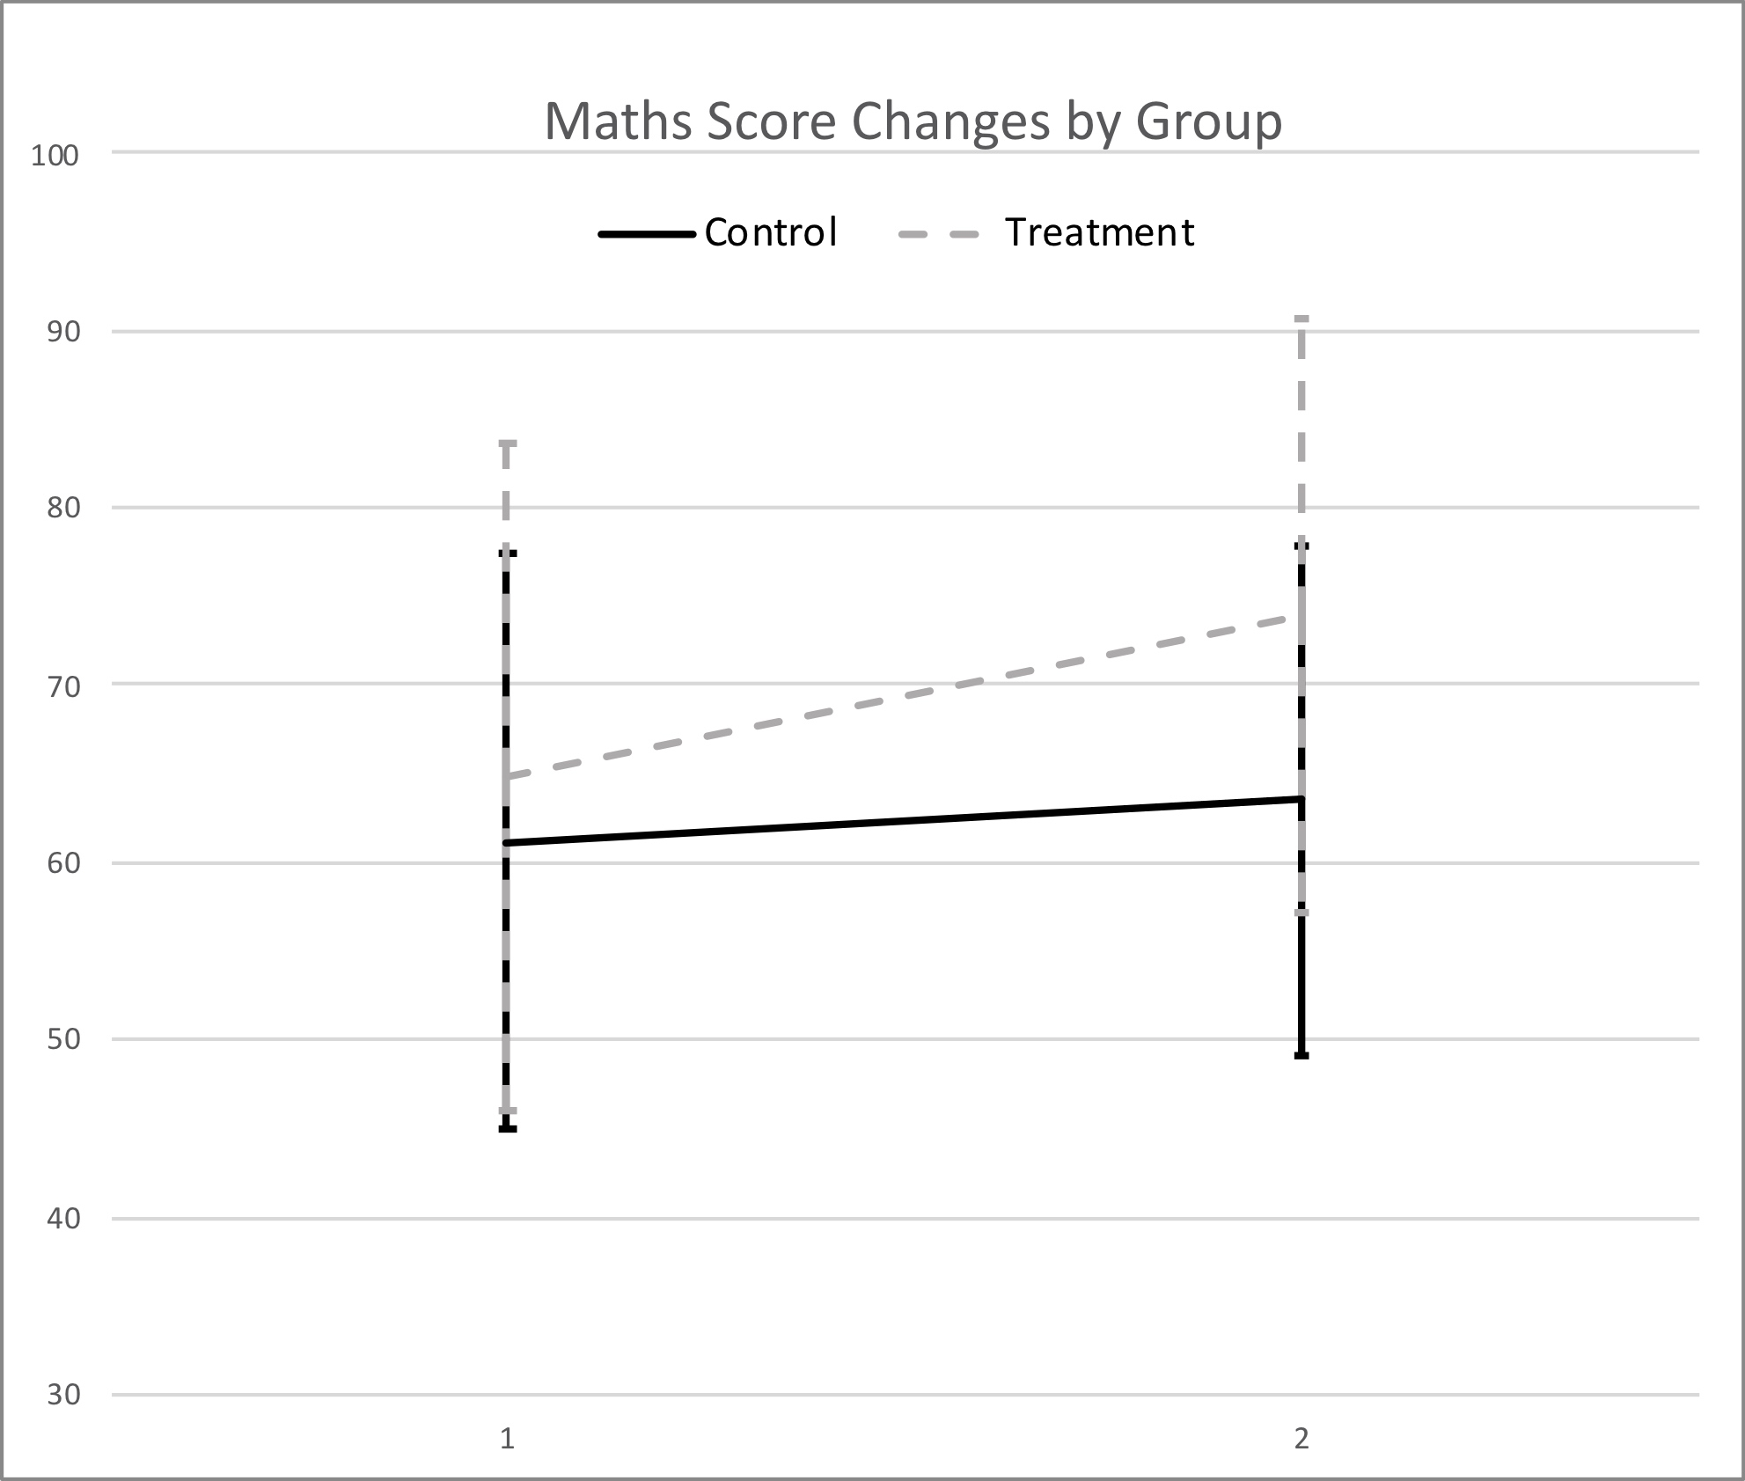
Error Bars Represent Standard Error

Slide 33
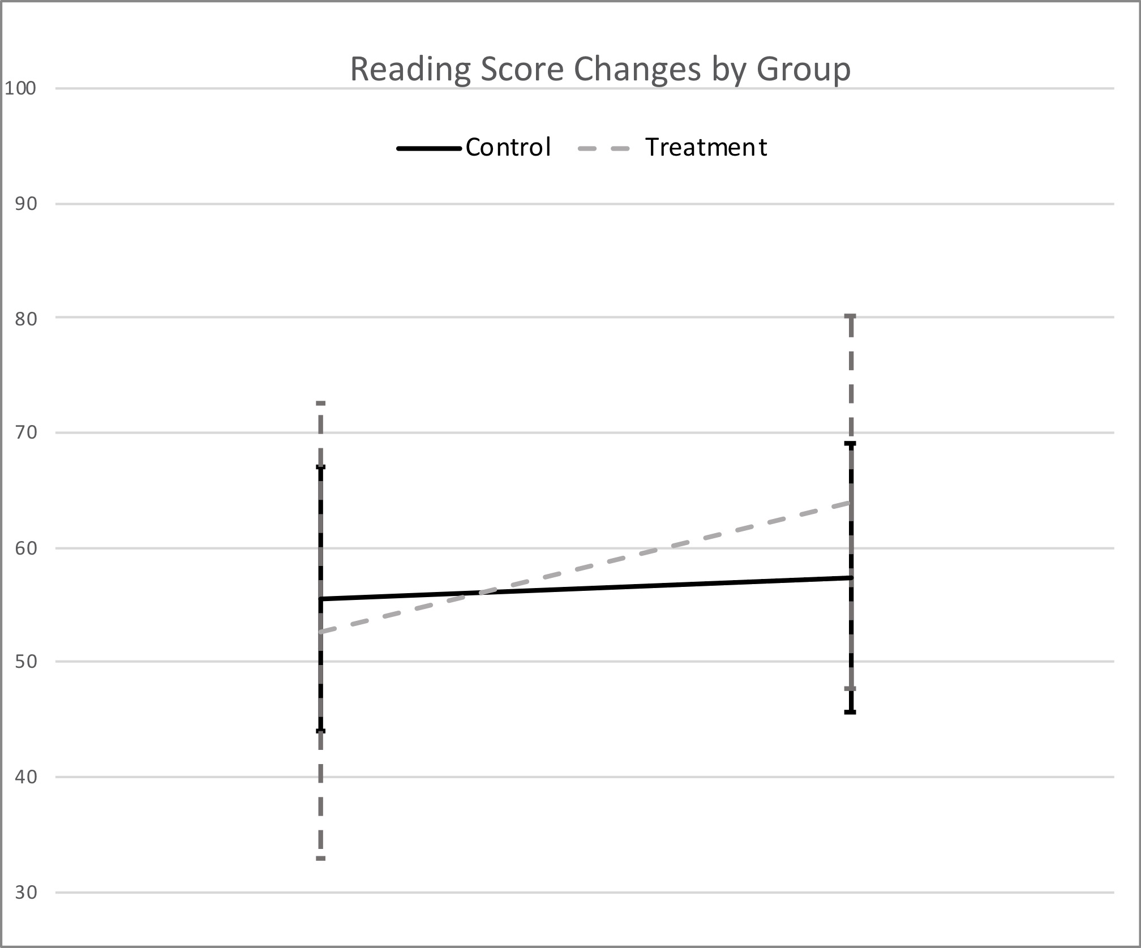
Error Bars Represent Standard Error

Slide 34
Conclusion
  First evidence that Relational Skills training can enhance academic aptitude using State-sanctioned assessments. These scores matter more than IQ in educational decision making.
  Both reading and mathematics scores were improved, even though ostensibly the training using a verbal problem-solving format and employs nonsense words only as stimuli (no numerical stimuli).
  Children were older than employed in most studies to date.
  Excellent control over training completion, but we need to further understand dose effects.

